Slide 1
Cloud Security Incident Management
Prepared by:
1- Rana Muhammad
2- Mohamed Ashraf
3- Ibrahim ELsayed
4- Yassin Nader
5- Moaz Mahmoud

Slide 2
Table of contents
01
02
03
04
05
Introduction
Security Measures
Cloud Environment Setup
1.1 Background
1.2 Objectives
3.1 Access Control
3.2 Data Security
3.3 Network Security
2.1 Infrastructure
2.2 Architecture Diagram
06
0fv935gig
Results
Monitoring & Incident Detection
Incident Response Plan (IRP)
8.1 Key Findings
8.2 Challenges & Solutions
4.1 Monitoring Tools
4.2 Alert Configuration
5.1 Preparation
5.2 Incident Phases

Slide 3

Introduction
Background: An introduction to cloud security risks, focusing on common threats such as DDoS attacks, unauthorized access, and misconfigured services.
Objectives: To create a secure cloud environment, implement monitoring and alert systems, and develop a robust incident response plan.

Slide 4
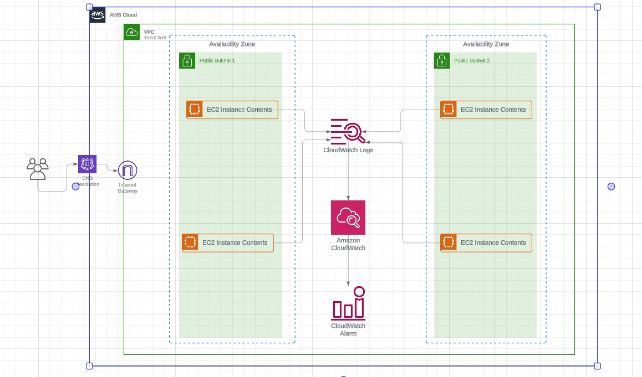
2. Cloud Environment Setup

Slide 5
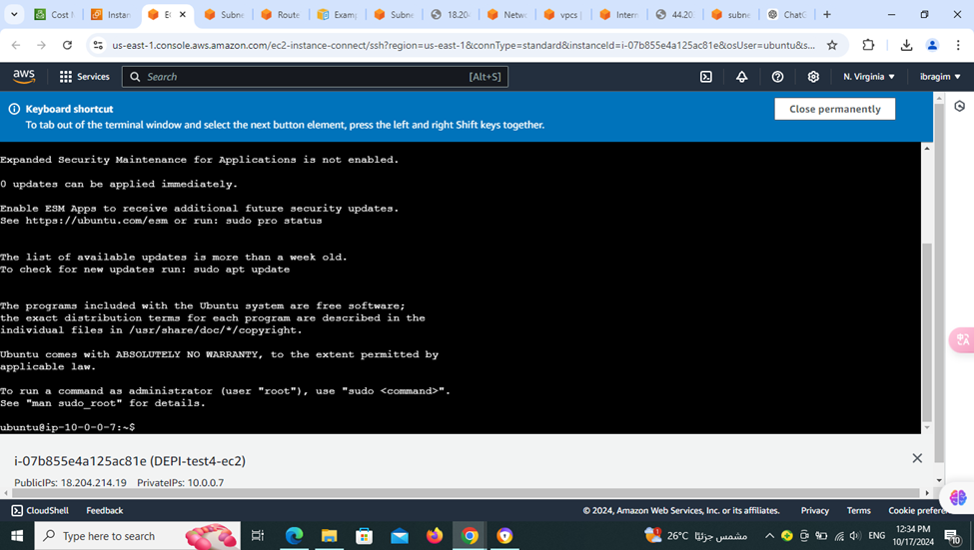
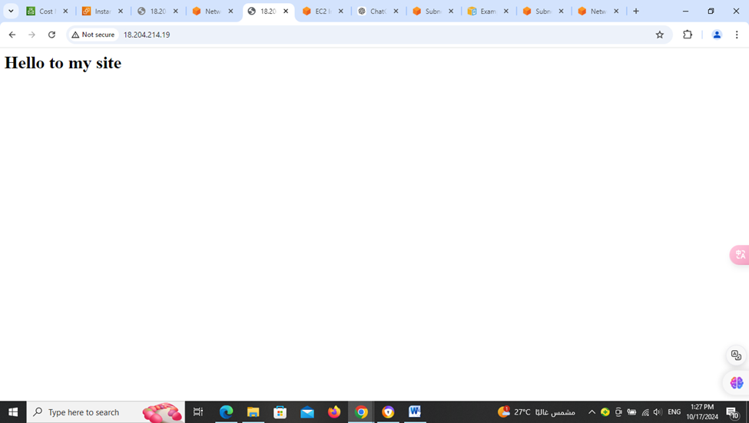
Steps for connecting EC2 inctance with cloud watch
1-First, we created EC2 inctance and installed apache server on it

Slide 6
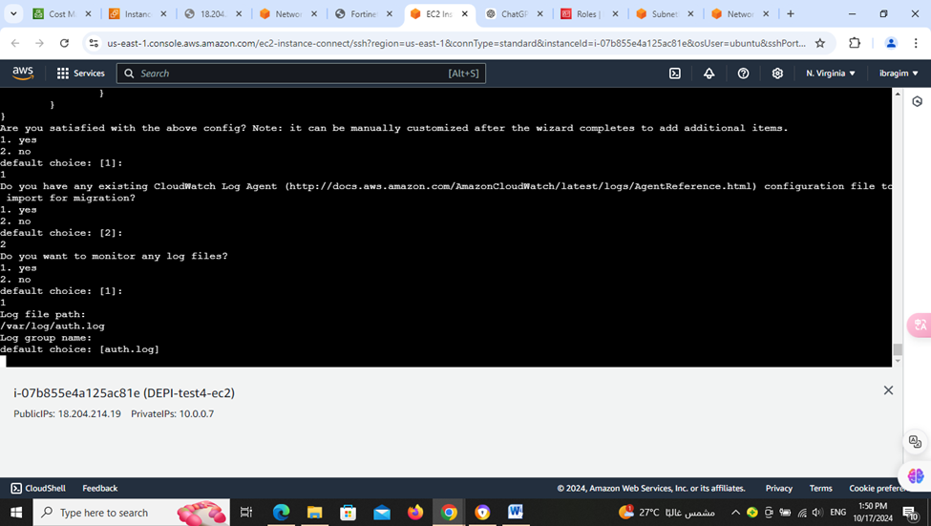

2- Second, setting up Cloud watch agent to connect EC2 Instances to cloud watch to monitor logs

Slide 7
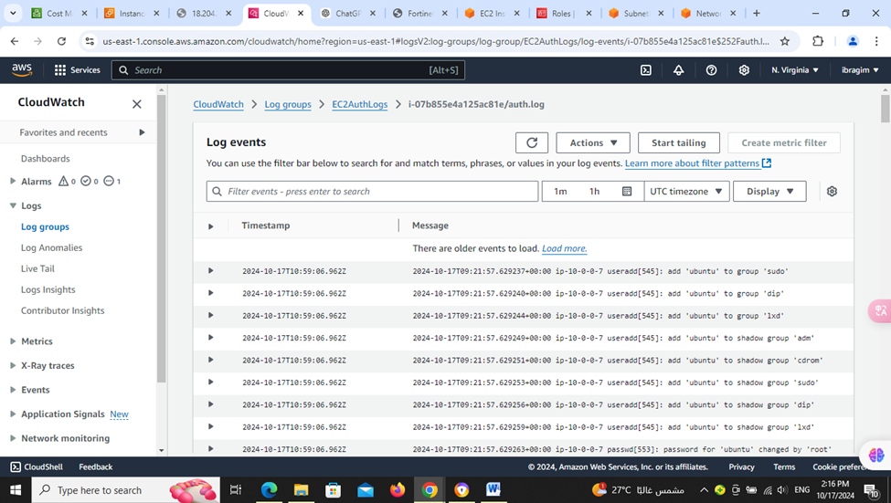
3- Third, Monitoring logs and test that cloudwatch is recieving logs

Slide 8
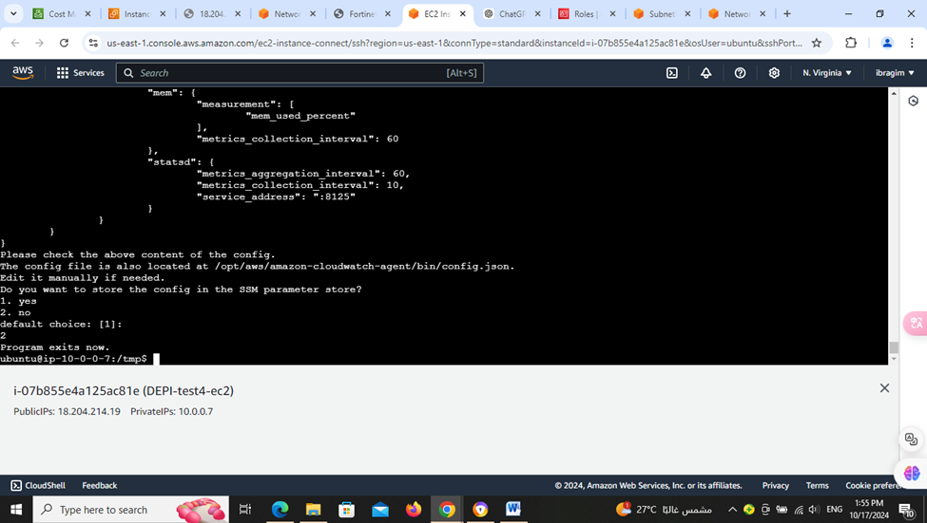
4- Then we created metrics for making the specs of the alarm requirement to take actions

Slide 9
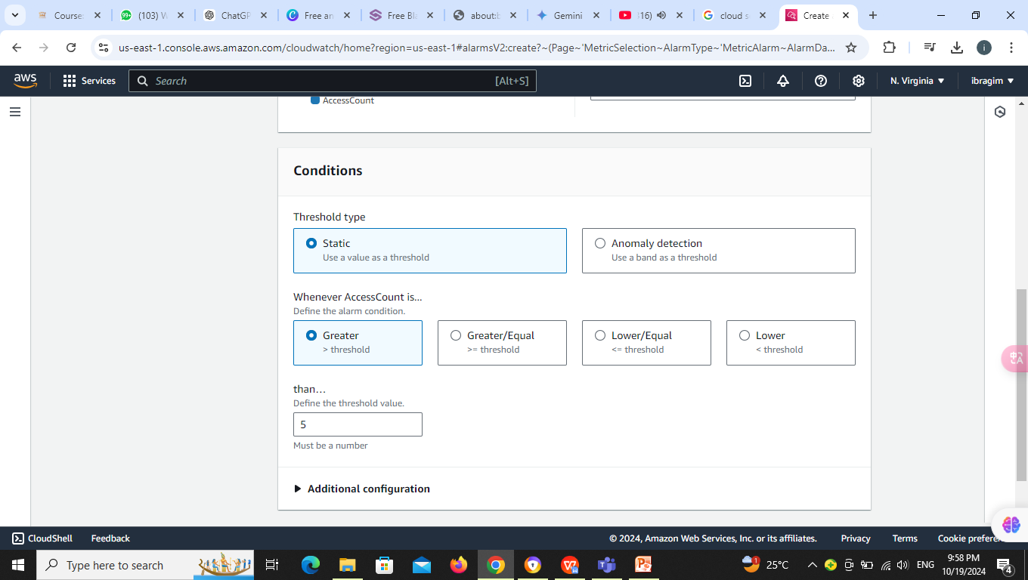
5- Then we created alarm to detect DDOS attacks if a IP address try to acces the site more than 5 times in 1 minute send an alert to take action

Slide 10
Security Measures
Internet Gateway manages external traffic.
Security Groups and Network ACLs control inbound and outbound traffic.
Load Balancer – CloudFront provide content delivery and distribute traffic across instances.
AWS WAF safeguards the application against common web exploits
AWS Shield mitigates Distributed Denial of Service (DDoS) attacks.

Slide 11
5. Incident Response Plan (IRP)
1- Identification
Monitoring systems (CloudWatch, VPC Flow Logs) used to detect unusual traffic patterns, indicating potential threats like DDoS attacks.
2- Containment
Short-term measures include blocking offending Ips
3- Eradication
Log analysis to pinpoint the source of malicious activities and update credentials if compromised.
4- Recovery
Restoration of services by redirecting traffic to backup regions and ensuring data integrity.
5- Post-Incident Review
Analysis of incident handling to identify areas for improvement.
…

Slide 12
Business continuity plan
Ensures that critical operations can continue during and after a disaster.
1st. Business Impact Analysis :Predicts the effect of a disruption.
2nd. Cloud Risk Assessment: Evaluate potential risks
3rd. Continuity Strategy :Ensure business functions continue during – after disruptions.
4th. Backup and Replication :Ensure data is regularly backed up.
5th. Communication Plan :how to communicate during a disruption.

Slide 13
Disaster recovery (DR) :
3rd. Recovery Procedures
Detailed Restoration Plan.
Automated Recovery.
Testing.
Monitoring and Maintenance.
4 th. Cloud Monitoring
Monitoring tools to detect issues early.
Plan updates.
Service level Agreements.
1st. Disaster Recovery Objectives
Set Recovery goals
Determine DR Site
2nd. DR Infrastructure
Cloud DR Setup
geographical Redundancy
Auto-Scaling and load Balancing

Slide 14
Results
Effectiveness of monitoring and alert systems in detecting unauthorized access and mitigating potential DDoS attacks.
Examples of logs and alarms that were triggered during the testing phase
Challenges
Issues encountered (e.g., false alarms, network latency) and how they were addressed.

Slide 15
Thank you

